Slide 1
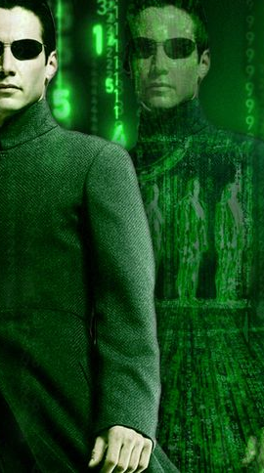
ITP 259: Basics of Artificial Intelligence Fall 2024 Lecture 3: Approaches to AI
Dr. Martin Prescher
Information technology Program
Viterbi school of engineering

Slide 2
“Never send a human to do a machine's job.”
- Agent smith, The Matrix

Slide 3
Outline
Approaches to AI
How does one make a machine intelligent?
What have been the approaches in the past?
What is the state-of-the-art?
Major categories
Rules based AI
Search
Machine Learning

Slide 4
AI Approaches
How do you get a machine to be intelligent?

Slide 5
70 years of different approaches to AI
Would it be “told” things we know about the world? Would it be “told” the rules, laws, principles, knowledge, reasoning, and everything else we think we know?
Would it work for ANI? Would this approach work for AGI?
Or would it “learn” through observation, experience, self correction, improvement? How would it know if its learning is “correct”?
Would it work for ANI? Would this approach work for AGI?
Any other approaches?
If you were to create an approach that would make a machine “intelligent”, what would it be?
Over the decades, various approaches have been taken to address artificial intelligence.

Slide 6
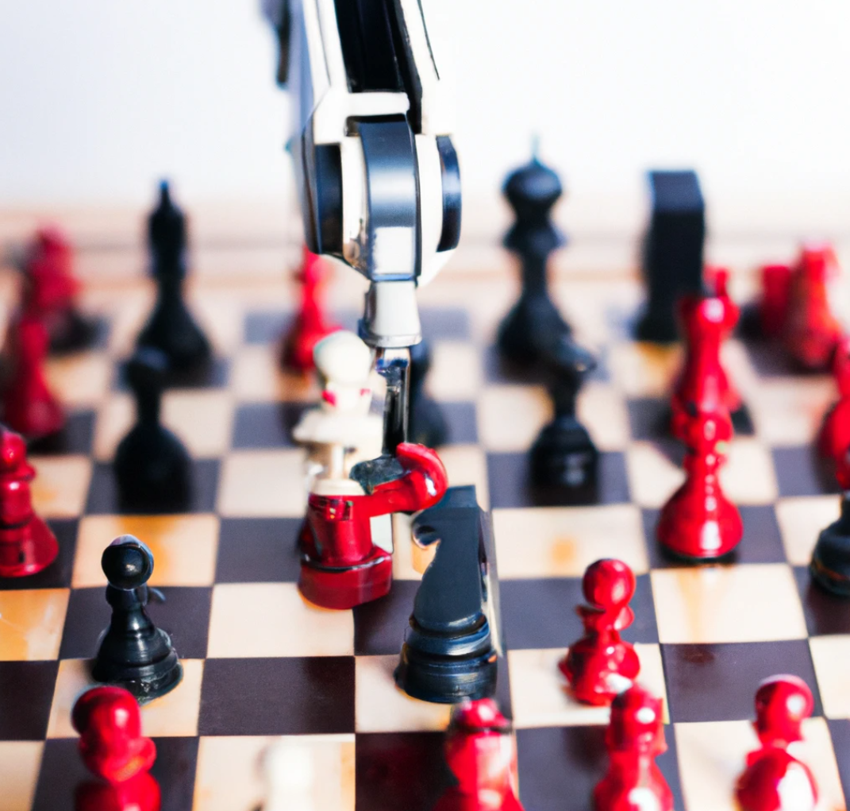
AI to play chess
How would you program a computer to play chess against humans?
How would you make the computer better at playing chess than any human?
Option 1: Try out every possible chess play and store it with known outcomes at every move. Then replay those against a human. Is this practical? 10¹²⁰ possible chess games (Shannon)!
Option 2: AI is given recorded histories of human games, especially grand masters, to learn from them.
Option 3: Game simulation – AI simulates any number of games and plays against itself. Then tries to learn strategies to win.
Option 4: Calculate the next best move by doing a tree search of possible moves and assigning evaluation function to each move.
Other: ?? Over time, will humans learn the moves of AI chess?
Created by Dall-E 2

Slide 7
Successes
Three main factors in recent successes
Compute: These approaches has taken advantage of advances in computer engineering (faster computation, massive storage, parallel processing).
Big Data: Explosion of digital data available for training models
Algorithms: Innovations in algorithms
Research interest is sparked by successes in AI which in turn increases funding.
Today, private industry is pouring funding because AI products are benefiting them.
Top researchers are highly sought after by companies.
Students with AI experience are being recruited.

Slide 8
Three major approaches to AI
Heuristics
Start: symbolic logic – express knowledge as symbols
Then use computer logic to draw inference
Preprogrammed as a series of rules
A giant if-then-else?
GOFAI – Good old fashioned Artificial Intelligence
Search
Start: chart out possible outcomes
Then use clever algorithms to do a search through the outcomes at each stage
Evaluate where to search next
Optimal search vs exhaustive search
Machine Learning
Start: show the computer large volumes of data and maybe it can learn from it
Neural network - Based on how the biological brain works
A network of neurons that can learn over time given data
Use machine learning to discover rules (or at least patterns)

Slide 9
Overview of AI Approaches
Heuristics
Symbolic
Search (discrete spaces)
Machine Learning
Unsupervised
Artificial Neural Network
CNN
RNN
LSTM
Autoencoders
Transformers
Regression
Classification
Support Vector Machines SVM
Markov process
Bayesian
Logical inference
Knowledge representation
Rule-based
Game playing
Expert Systems
Fuzzy Logic
Ontologies
Semantic web
Supervised
Statistical
Reinforcement learning
Clustering
Association
Dimension Reduction (e.g. PCA)
GAN
Informed (Heuristic) Search
Minmax Search (can be heuristic search)
A* Search
Simulated Annealing
Traveling Salesman e.g. Dijkstra)
Uniform Cost
Local Search
Hill Climbing
Best-First (Greedy) Search
Breadth First (BFS)
Tabu Search
Uninformed (Brute Force) Search
Depth First (DFS)
Genetic Algorithms
For these algorithms you don’t have to supply a heuristics function
These search techniques do not follow any higher-level goals
These search techniques are goal oriented
Very popular, it finds the next node by minimizing a function f=g+h with g being the cost to the next node and h being the estimated cost to get to the final goal
These search techniques start with a ‘state’ and iteratively try to improve it
These search techniques start with a possible solution (population), and find different ones by ‘mutating’ population parameters
In continuous spaces this is the famous gradient descent algorithm (we will use it!)
Not exhaustive!

Slide 10
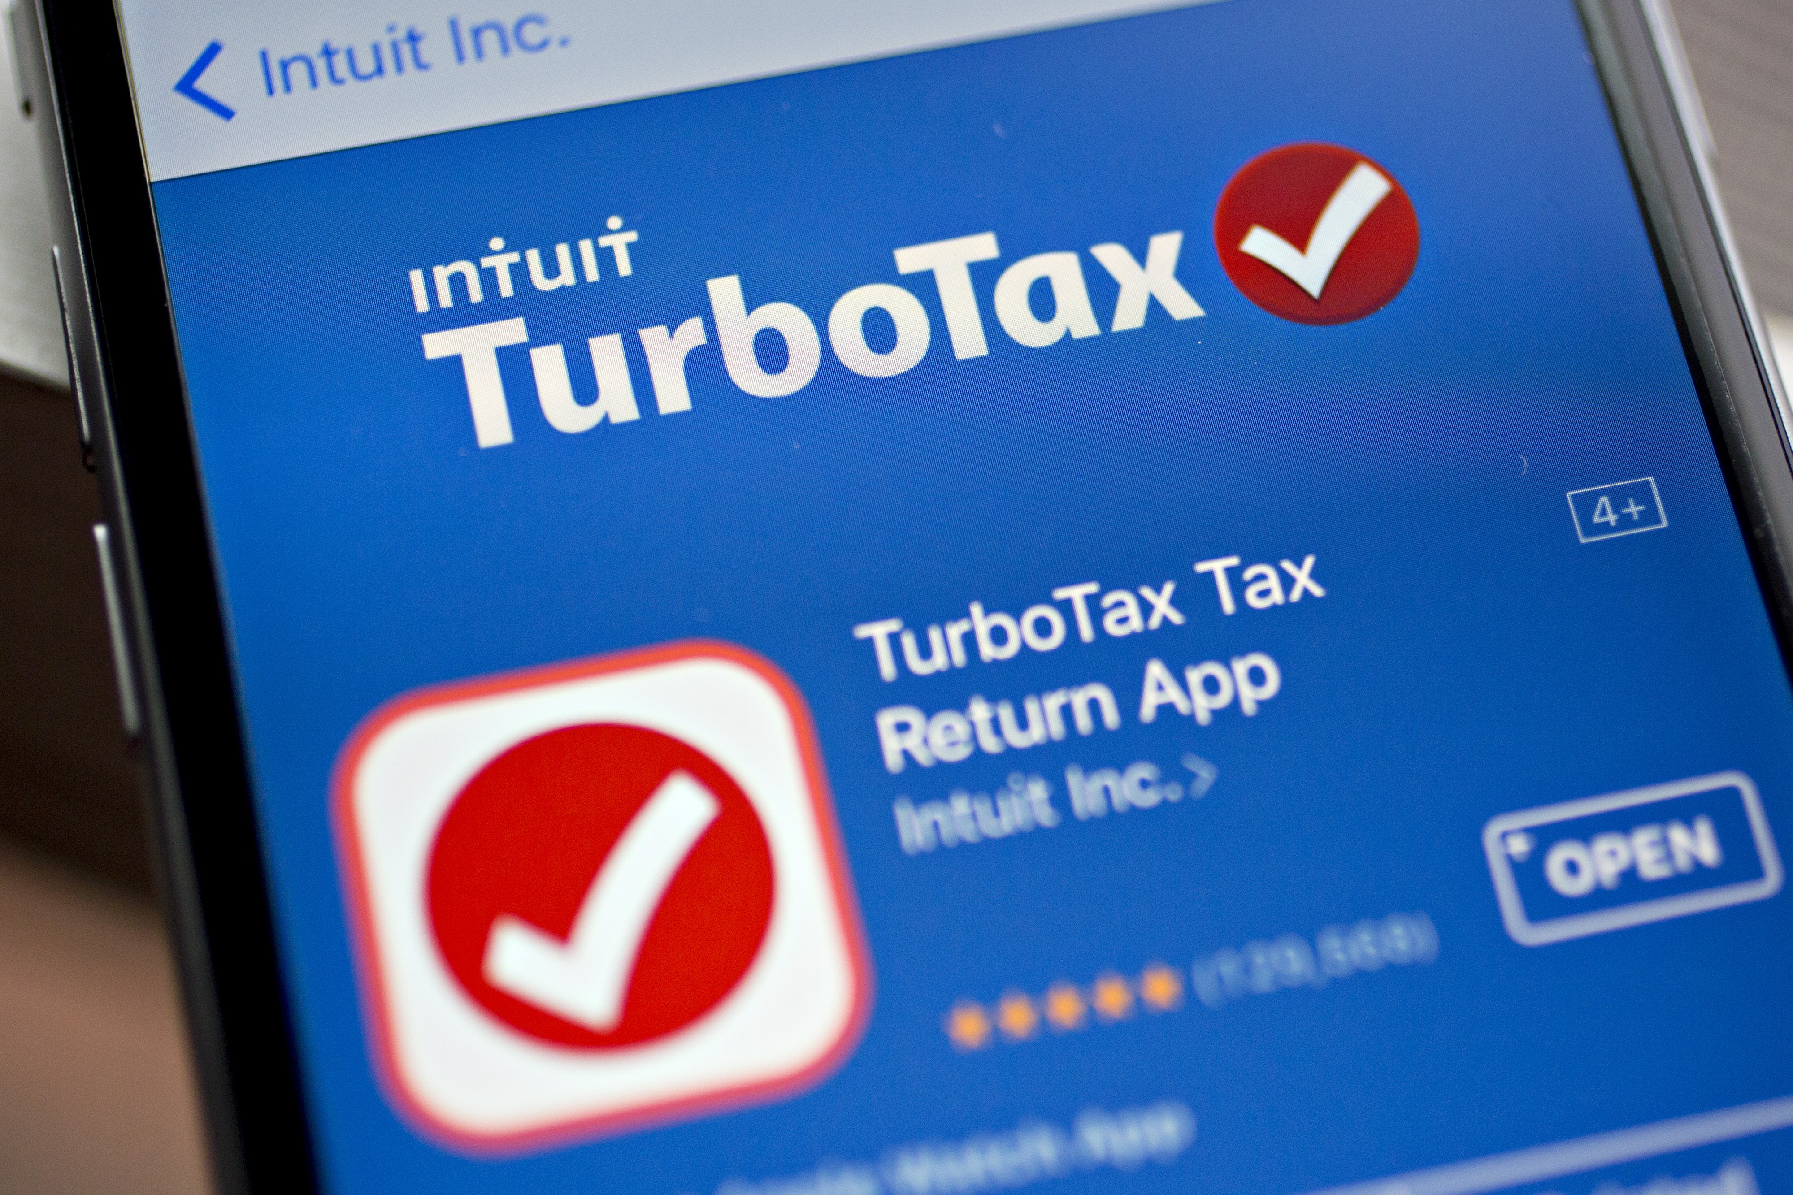
Expert Systems
Human-like decision making
Use reasoning based on
Rules based (rule-based searches)
Inference based (to infer from known facts to deduce new facts)
Give the computer any number of rules in a domain
Very popular in the 1980s
E.g. Tax returns software
Divided into two subsystems:
knowledge base that represents facts and rules.
inference engine that applies the rules to the known facts and deduces new facts.
Advantages: Decisions made by machine could be scrutinized. Relatively fast decision making.
Drawbacks: Rules were encoded by human experts. Could encode human biases. No real understanding of ideas. Not self-learning.

Slide 11
Expert Systems
Launch
Success
Study the problem, understand the rules
Code the rules
Evaluate / Test
Data
Failure
Analyze what broke

Slide 12

Symbolic AI
Symbolic representation of problems and knowledge
It is based on the notion that the brain understand the world by forming a symbolic representation of its surroundings.
Symbols are abstractions of real-world objects, ideas, concepts, rules.
Uses symbols rather than data to represent the world.
Symbols are used to represent knowledge (facts), then inference is used to reason.
Wolfram Research - Mathematica

Slide 13
Overview of AI Approaches
Heuristics
Symbolic
Search (discrete spaces)
Machine Learning
Unsupervised
Artificial Neural Network
CNN
RNN
LSTM
Autoencoders
Transformers
Regression
Classification
Support Vector Machines SVM
Markov process
Bayesian
Logical inference
Knowledge representation
Rule-based
Game playing
Expert Systems
Fuzzy Logic
Ontologies
Semantic web
Supervised
Statistical
Reinforcement learning
Clustering
Association
Dimension Reduction (e.g. PCA)
GAN
Informed (Heuristic) Search
Minmax Search (can be heuristic search)
A* Search
Simulated Annealing
Traveling Salesman e.g. Dijkstra)
Uniform Cost
Local Search
Hill Climbing
Best-First (Greedy) Search
Breadth First (BFS)
Tabu Search
Uninformed (Brute Force) Search
Depth First (DFS)
Genetic Algorithms
For these algorithms you don’t have to supply a heuristics function
These search techniques do not follow any higher-level goals
These search techniques are goal oriented
Very popular, it finds the next node by minimizing a function f=g+h with g being the cost to the next node and h being the estimated cost to get to the final goal
These search techniques start with a ‘state’ and iteratively try to improve it
These search techniques start with a possible solution (population), and find different ones by ‘mutating’ population parameters
In continuous spaces this is the famous gradient descent algorithm (we will use it!)
Not exhaustive!

Slide 14
Search
Be able to find answers, make decisions or take a course of action
Finding the ‘right’ answer depends on what we mean by right or getting close enough.
Searches could stop when we get close enough, or keep looking and compare candidate answers to find the best.

Slide 15
Example Search
See Colab Example!
Linear Search
Input: list list[] of size n; target t
function int find_target_in_list(array list[], int t)
{
for i = 0 to n - 1 do
if list[i] == x then
return i
end if
i=i+1
end for
if i == n then
return -1
}
Depth First Search (DFS)
1
2
3
4
5
6
7

Slide 16
Overview of AI Approaches
Heuristics
Symbolic
Search (discrete spaces)
Machine Learning
Unsupervised
Artificial Neural Network
CNN
RNN
LSTM
Autoencoders
Transformers
Regression
Classification
Support Vector Machines SVM
Markov process
Bayesian
Logical inference
Knowledge representation
Rule-based
Game playing
Expert Systems
Fuzzy Logic
Ontologies
Semantic web
Supervised
Statistical
Reinforcement learning
Clustering
Association
Dimension Reduction (e.g. PCA)
GAN
Informed (Heuristic) Search
Minmax Search (can be heuristic search)
A* Search
Simulated Annealing
Traveling Salesman e.g. Dijkstra)
Uniform Cost
Local Search
Hill Climbing
Best-First (Greedy) Search
Breadth First (BFS)
Tabu Search
Uninformed (Brute Force) Search
Depth First (DFS)
Genetic Algorithms
For these algorithms you don’t have to supply a heuristics function
These search techniques do not follow any higher-level goals
These search techniques are goal oriented
Very popular, it finds the next node by minimizing a function f=g+h with g being the cost to the next node and h being the estimated cost to get to the final goal
These search techniques start with a ‘state’ and iteratively try to improve it
These search techniques start with a possible solution (population), and find different ones by ‘mutating’ population parameters
In continuous spaces this is the famous gradient descent algorithm (we will use it!)
Not exhaustive!

Slide 17
Machine Learning
Computer programs that learn from training and experience using vast amounts of data.
Build models based on training data from which predictions can be made on test data.
Supervised
Unsupervised (also semi-supervised and self-supervised)
Reinforcement Learning

Slide 18
Machine Learning
Prediction Results
Create Training Data
Feedback loop (e.g. Reinforcement Learning)
Study the problem, understand the data
Train ML Algorithm
Model
New Data
Monitoring
Deficiencies
Analyze Results
(e.g. accuracy, biases, overfitting, etc.)

Slide 19
Feature Engineering -> Deep Learning
The problem with data is that not all is useful. Meaningful input data (i.e. data that has predictive capability) is also called features and feature engineering is the process of extracting features from the raw data. When dealing with different kinds of data, you need to figure out ways to represent this data in order to extract meaningful information from it.
A neural network is a system that learns how to make predictions by following these steps:
Take the input data
Make a prediction
Compare the prediction to the desired output
Adjust its internal parameters to predict correctly the next time
Deep learning is an evolution which lets the neural network figure out by itself which features are important instead of applying feature engineering techniques. That way we can bypass Feature Engineering which can be very complex for large and unknown datasets!

Slide 20
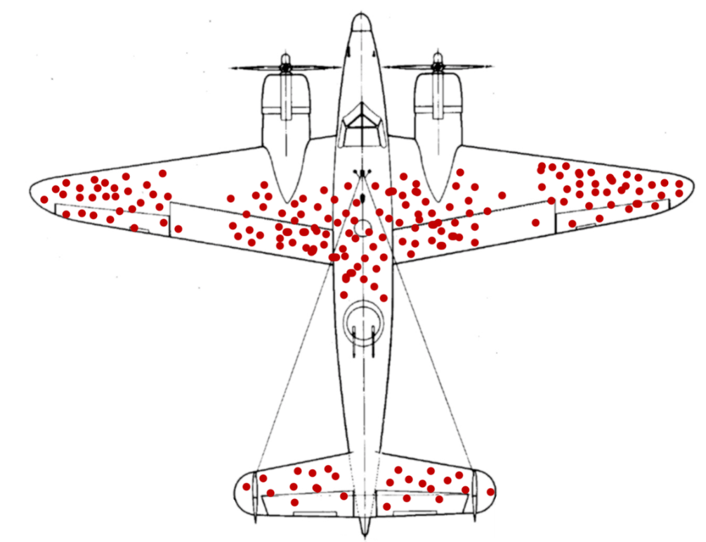
One example on Bias: survivor Bias
It is of CRUCIAL importance to understand that anything that learns (human, animal, machine) can only learn as much as what’s given in the data.
Therefore, feeding in the right datasets that fit the problem I’m trying to solve is 90% of solving the problem. If you feed in incomplete data or data with BIASES you will get bad predictions.
Example for a bias: Survivor Bias. This is a famous example for a bias effect in the data due to a focus on successful outcomes and a neglect of failed or underperforming instances when drawing conclusions.

Slide 21
We already mentioned this one: Bias! Fico Score
Another real world example of biases in data: the FICO score!
The Fico score predict the likelihood that a person will pay back a loan.
It uses data from past loans to make these predictions.
Who can spot the bias?

Slide 22
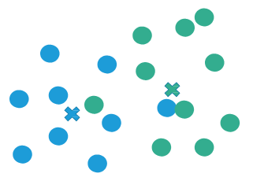
Clustering
Clustering entails grouping together data points that are similar to one another.
Each data point within a cluster is similar to the others within the cluster, and it is dissimilar to the data points in other clusters.
In this figure, how many clusters of similar items do you see? Two.
All blue dots are similar
All green dots are similar
And blue dots and green dots are dissimilar

Slide 23
Association
Association analysis is the technique of finding hidden relationships between and among sets of items that frequently occur together in a dataset.
Association analysis examines a group of transactions and then determines the rules that predict the probability that a particular item will occur in a transaction based on the frequency with which other items occur
A transaction in association analysis, we are referring to a collection of items that occur together in an identifiable event.
Association analysis is also called affinity analysis
Businesses can use these associations to promote and recommend items that often occur together; for example, pizza and soft drinks
The rules that are generated by associational analysis are called association rules.
An example of an association rule is {PIZZA-BY-THE-SLICE} → {SOFT DRINK 20 OZ}.
This rule simply states that when people buy pizza by the slice they also buy a 20-ounce soft drink.
Further, association rules can be evaluated for strength.
Stronger rules imply greater association.
The items on the left side of the arrow are called antecedents.
The items on the right side are called consequents.
The general format of the rule is:
If (antecedent(s)) Then (consequent(s)).

Slide 24
Number of rules
If the transaction includes only two items, then there will be only 2 rules.
Three items will generate 12 rules.
With just 10 items, the number of rules grows to 57,000!
Excessive numbers of rules represent an obstacle to effective analysis.
Not only are they time consuming to construct, but they are also unwieldy to understand and interpret.

Slide 25
Metrics for association rules
The frequency and strength of association rules are measured by three ratios
Support
Confidence
Lift

Slide 26
Example
Breadbasket
Data set containing more than 6000 transactions from a bakery.
Transaction ID | Bread | Scandinavian | Hot Chocolate | Jam | Cookies | Muffin | Coffee | Pastry | Medialuna
1 | 1 | 0 | 0 | 0 | 0 | 0 | 0 | 0 | 0
2 | 0 | 1 | 0 | 0 | 0 | 0 | 0 | 0 | 0
3 | 0 | 0 | 1 | 1 | 1 | 0 | 0 | 0 | 0
4 | 0 | 0 | 0 | 0 | 0 | 1 | 0 | 0 | 0
5 | 1 | 0 | 0 | 0 | 0 | 0 | 1 | 1 | 0
6 | 0 | 0 | 0 | 0 | 0 | 1 | 0 | 1 | 1
7 | 1 | 0 | 0 | 0 | 0 | 0 | 1 | 1 | 1

Slide 27
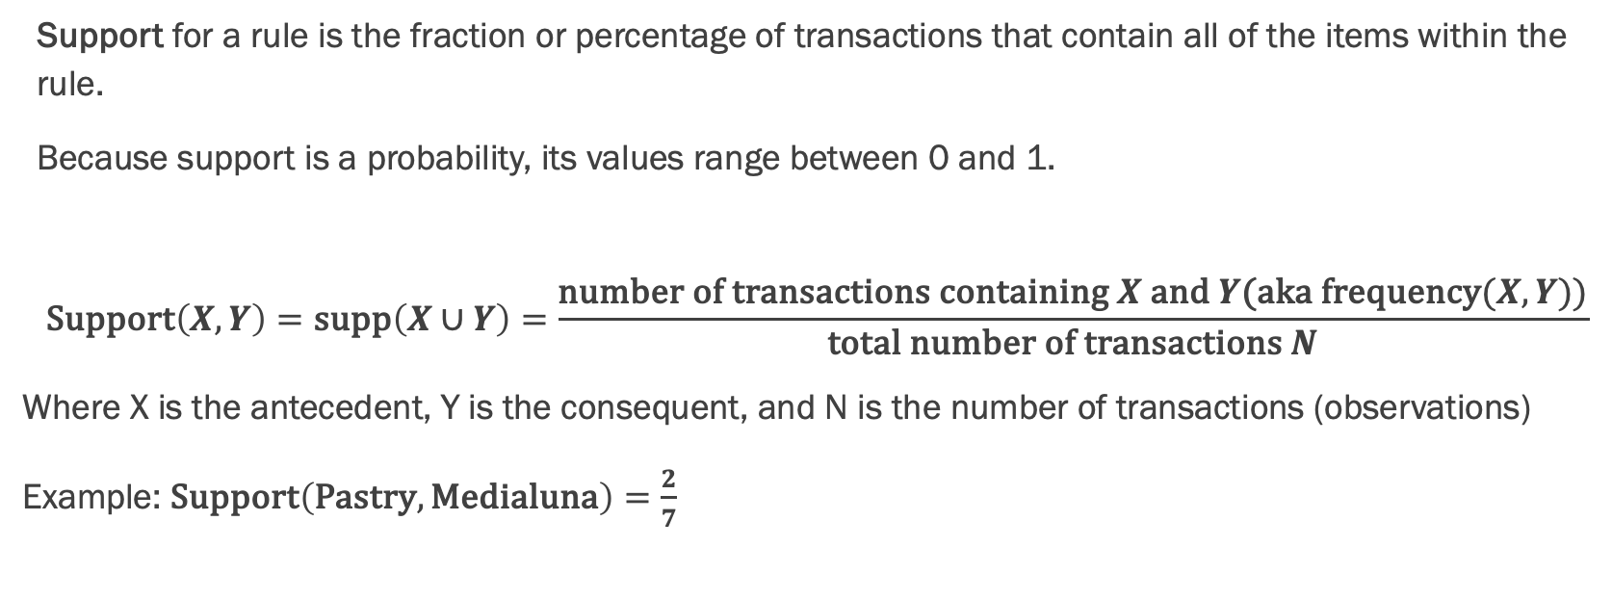
Support
Support for a rule is the fraction or percentage of transactions that contain all of the items within the rule.
Because support is a probability, its values range between 0 and 1.
$$\text{Support}\left(X,Y\right)=\text{supp}\left(X∪Y\right)=\frac{\text{number} \text{of} \text{transactions} \text{containing} X \text{and} Y\text{(}\text{aka} \text{frequency}(X,Y))}{\text{total} \text{number} \text{of} \text{transactions} N}$$
Where X is the antecedent, Y is the consequent, and N is the number of transactions (observations)
Example: $\text{Support}\left(\text{Pastry},\text{Medialuna}\right)=\frac{2}{7}$

Slide 28
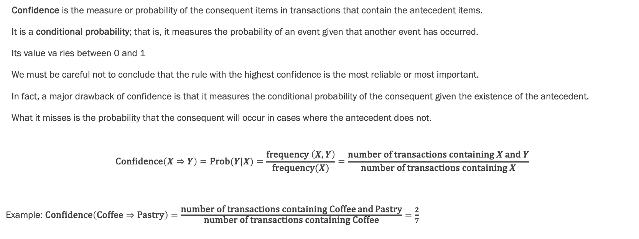
Confidence
Confidence is the measure or probability of the consequent items in transactions that contain the antecedent items.
It is a conditional probability; that is, it measures the probability of an event given that another event has occurred.
Its value va ries between 0 and 1
We must be careful not to conclude that the rule with the highest confidence is the most reliable or most important.
In fact, a major drawback of confidence is that it measures the conditional probability of the consequent given the existence of the antecedent.
What it misses is the probability that the consequent will occur in cases where the antecedent does not.
$$\text{Confidence}\left(X⇒Y\right)=\text{Prob}(Y|X)=\frac{\text{frequency} \left(X,Y\right)}{\text{frequency}(X)}=\frac{\text{number} \text{of} \text{transactions} \text{containing} X \text{and} Y}{\text{number} \text{of} \text{transactions} \text{containing} X}$$
Example: $\text{Confidence}\left(\text{Coffee}⇒\text{Pastry}\right)=\frac{\text{number} \text{of} \text{transactions} \text{containing} \text{Coffee} \text{and} \text{Pastry}}{\text{number} \text{of} \text{transactions} \text{containing} \text{Coffee}}=\frac{2}{7}$

Slide 29
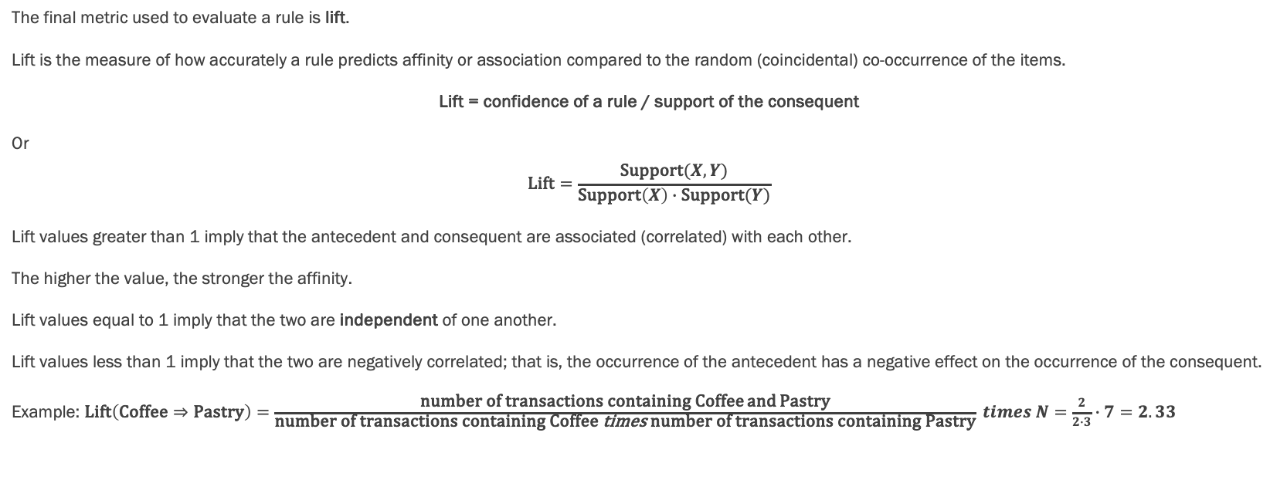
Lift
The final metric used to evaluate a rule is lift.
Lift is the measure of how accurately a rule predicts affinity or association compared to the random (coincidental) co-occurrence of the items.
Lift = confidence of a rule / support of the consequent
Or
$$\text{Lift}=\frac{\text{Support}(X,Y)}{\text{Support}\left(X\right)∙\text{Support}(Y)}$$
Lift values greater than 1 imply that the antecedent and consequent are associated (correlated) with each other.
The higher the value, the stronger the affinity.
Lift values equal to 1 imply that the two are independent of one another.
Lift values less than 1 imply that the two are negatively correlated; that is, the occurrence of the antecedent has a negative effect on the occurrence of the consequent.
Example: $\text{Lift}\left(\text{Coffee}⇒\text{Pastry}\right)=\frac{\text{number} \text{of} \text{transactions} \text{containing} \text{Coffee} \text{and} \text{Pastry}}{\text{number} \text{of} \text{transactions} \text{containing} \text{Coffee} \text{times} \text{number} \text{of} \text{transactions} \text{containing} \text{Pastry}} times N=\frac{2}{2∙3}∙7=2.33$

Slide 30
Rule reduction
Most data mining tools include an implementation of the apriori algorithm that makes association analysis straightforward and trims out the infrequent rules by default.
Apriori starts by identifying frequently occurring single items within the dataset and then expanding to the sets of two items that contain that frequently occurring item and then three items and so on. It uses Breadth-First-Search (BFS).
These data mining tools also have threshold settings for support, confidence, and lift so that a user can limit the number of resulting rules.

Slide 31
Rule reduction
Example:
First Step: We create the sets of occurring items:
{Bread}, {Scandinavian}, {Hot Choc, Jam, Cookies}, {Muffin}, {Bread, Coffee, Pastry}, {Muffin, Pastry, Medialuna}, {Bread, Coffee, Pastry, Medialuna}
Now we count the occurrence of each individual item:
Lets say we already introduce a threshold of 2 to be included as a frequent item:
Next step is to create permutations of these items by expanding to lists of 2: {Bread, Muffin}, {Bread, Coffee}, {Bread, Pastry}, {Bread. Medialuna}, {Muffin, Coffee}, {Muffin, Pastry}, {Muffin, Medialuna} and so forth. We then count how often they occur in the data set.
We then apply a threshold again and could filter only occurrences of >1.
We would then continue to make triplets and so on.
The algorithm will stop at level 4 since we do not have any quintuplets.
Bread | Scan. | Hot Choc | Jam | Cookies | Muffin | Coffee | Pastry | Medialuna
3 | 1 | 1 | 1 | 1 | 2 | 2 | 3 | 2
Bread | Muffin | Coffee | Pastry | Medialuna
3 | 2 | 2 | 3 | 2
Bread, Muffin | Bread, Coffee | Bread, Pastry | Bread, Medialuna | Muffin, Coffee | Muffin, Pastry | Muffin, Medialuna | …
0 | 2 | 2 | 1 | 0 | 0 | 1

Slide 32
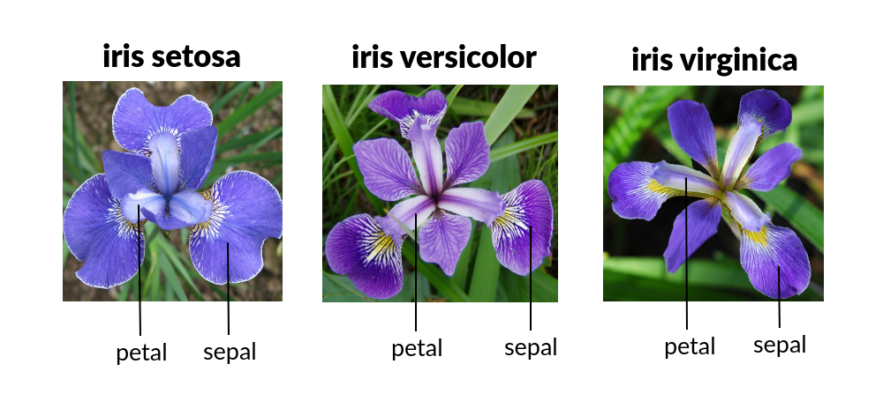
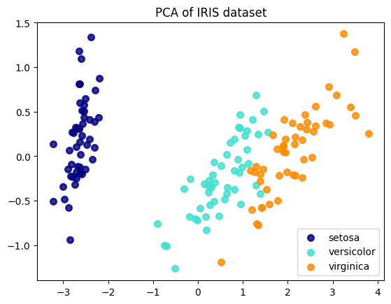
Dimension Reduction - Principal Components Analysis
High dimensionality is a big problem in Machine Learning. It can lead to overfitting of models, and high compute costs.
Reduce a high dimensional data to lower dimensional data.
The dimensions that are not retained do not have high variance in the data, so the loss of data is acceptable.
PCA finds a new set of dimensions (or a set of basis vectors, called the Eigenvectors) such that all the dimensions are orthogonal (and hence linearly independent). These are then ranked according to the variance of data along them.
Due to the orthogonality PCA transforms data into new properties (features) that are not correlated to each other.
Example: Iris data set. Predict the Iris flower species by using features such as sepal length, sepal width, petal length, petal width. Total 4 features.
By doing PCA, we can reduce the dimensionality to 3 or even 2, while keep over 97% of the variation.
PCA 2
PCA 1
Variance ratio (first two components): [0.92461872 0.05306648]
https://www.math.umd.edu/~petersd/666/html/iris_pca.html

Slide 33
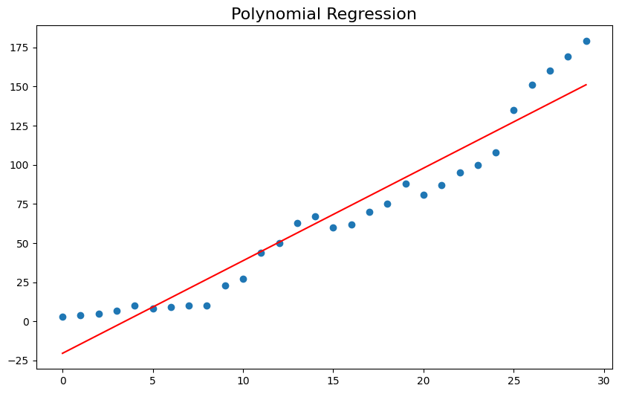
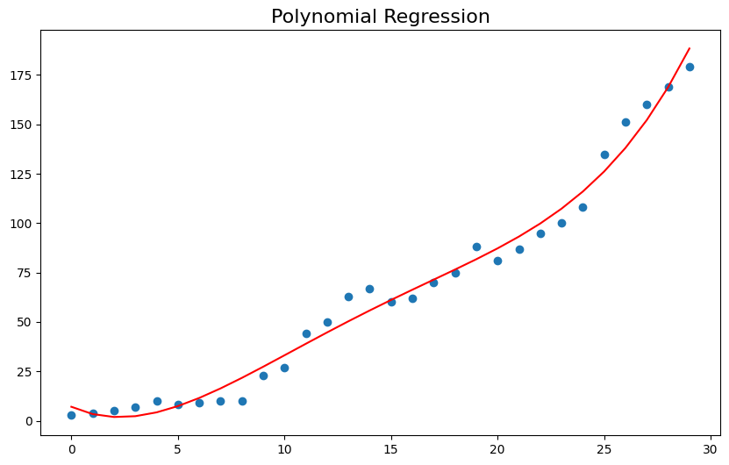
Regression
The process of estimating or defining the relationships between and among variables and developing a prediction model.
In other words, it answers the question of which variable(s) affect another variable and in what way (linear equation).
Acidity and Wine score
Age and Weight, Height and Weight
The target (dependent) variable is numeric. The predictor (independent) variable is usually numeric.
Simple Linear Regression
Multiple Linear Regression
Simple linear regression creates an arithmetic equation to explain the relationship between independent and dependent variables.
The independent variable is also called the predictor or explanatory variable, and the dependent variable is also called the target variable.
The goal of simple linear regression is to fit a straight line (or a polyomial) through the points on a chart between the dependent and independent variables

Slide 34
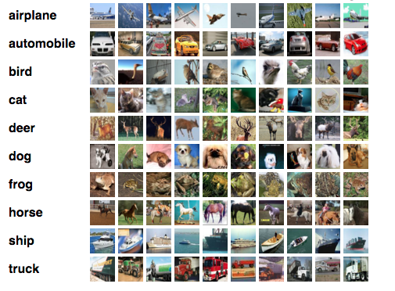
Classification
Given labeled data set, train a model to classify samples (observations) into classes.
E.g. given 1000 images of cats (which are labeled “cat”). Train a model. Then show a new image and the model should classify if the image is cat or not a cat.
Later in the semester we will train a model to classify images into 10 classes.

Slide 35
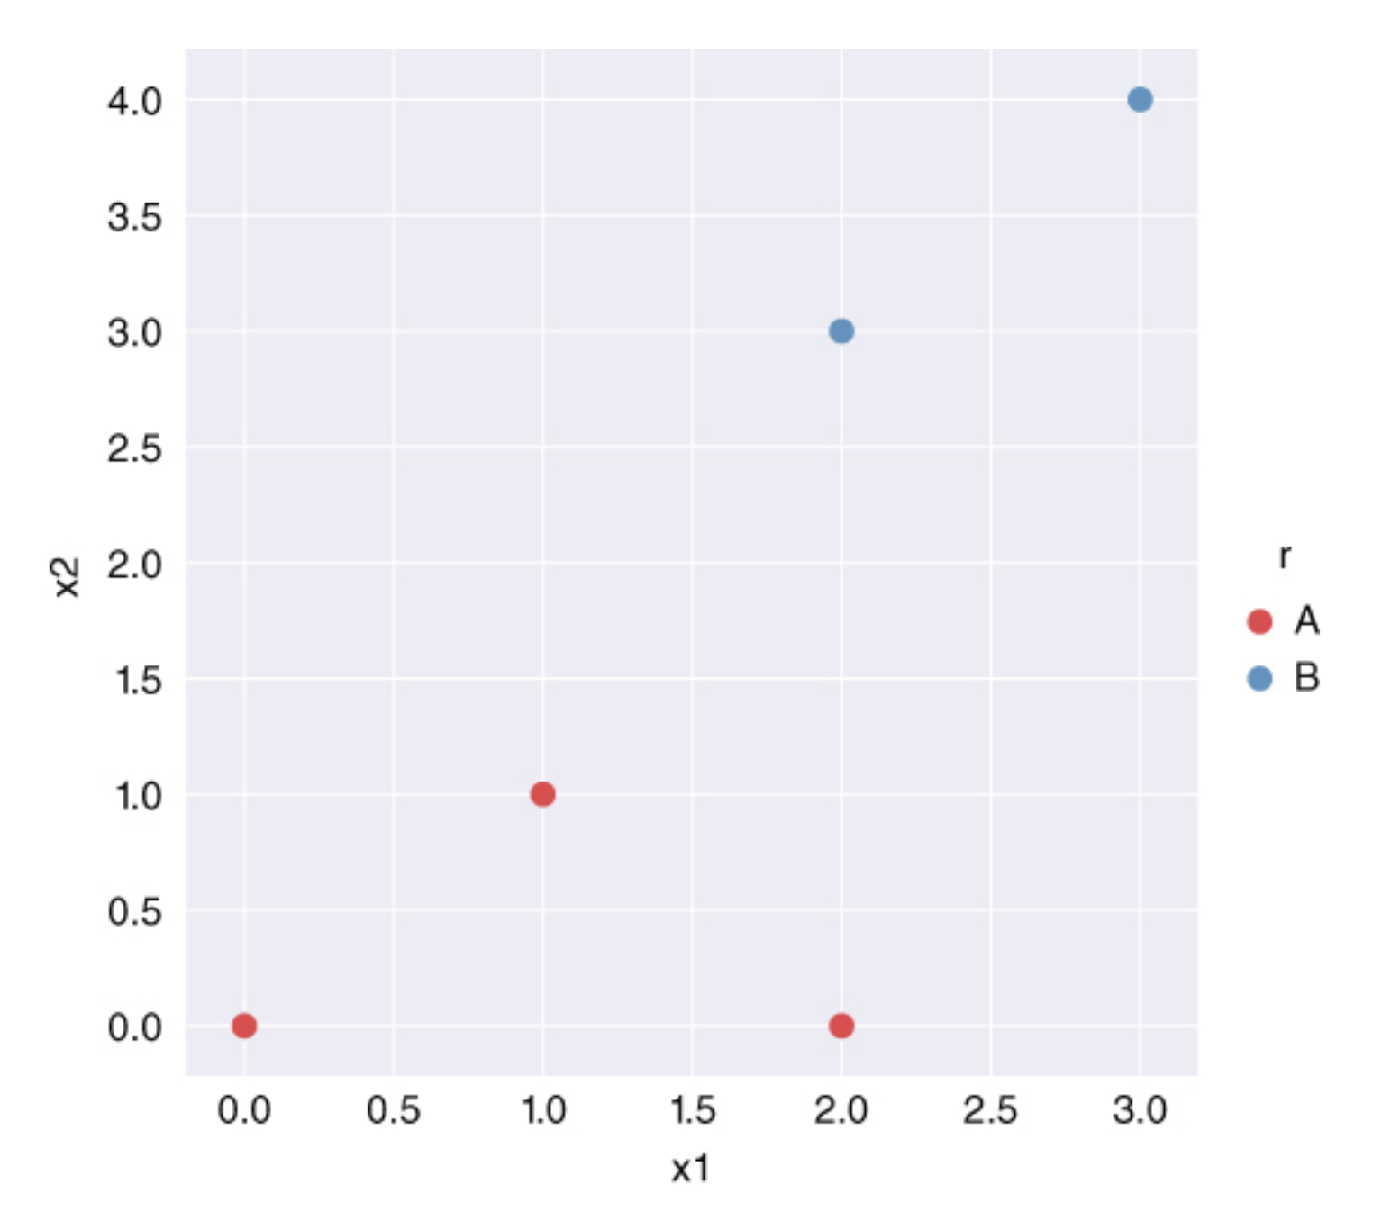
Support Vector Machines
Used to predict categories and solve classification machine learning problems by defining a boundary between categories such that it maximizes the margin between classification groups.
Problem: Draw a line (hyperplane) on the chart so as to distinctly classify the data points into red and blue classes.
Many such lines are possible. Find one that yields the maximum margin. The highest distance between the points.

Slide 36
Neural Networks
Artificial Neural Networks
Deep NN
Convolutional NN
Recurrent NN
Generative Adversarial Network
Long Short-term Memory LSTM
Autoencoders
Transformers
A collection of interconnected nodes which try to mimic the brain’s biological network of neurons.
Several categories of neural networks for machine learning exist and active research continues to invent more
Of course, mimicking the human brain is not necessary for AI, much the same way that the Wright brothers did not have to imitate birds to build a flying machine.

Slide 37
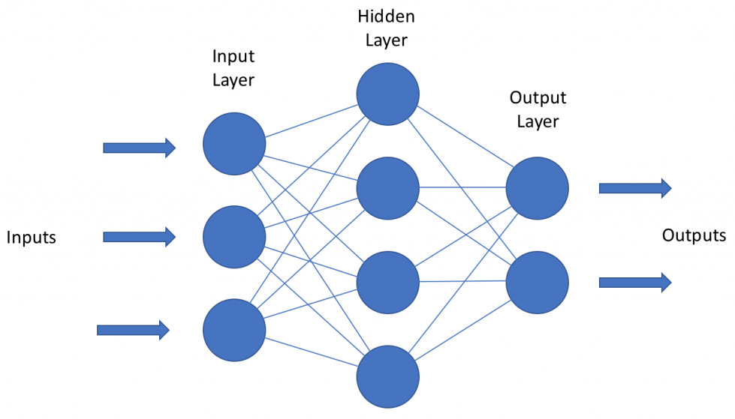
Artificial Neural Network (ANN)
ANN attempts to use a neuron-like network to map inputs to outputs. Or features (factors) and responses (target)
ANN or just NN is a multi-layer set of nodes (neurons).
Information flows from inputs through each layer to outputs in this directed graph (no recursion or looping). Each layer performs computation on the input from the layer before it. And the output moves forward. That makes this particular type of NN a feedforward Neural Network.
The goal is to use this network to perform a classification or regression problem.

Slide 38

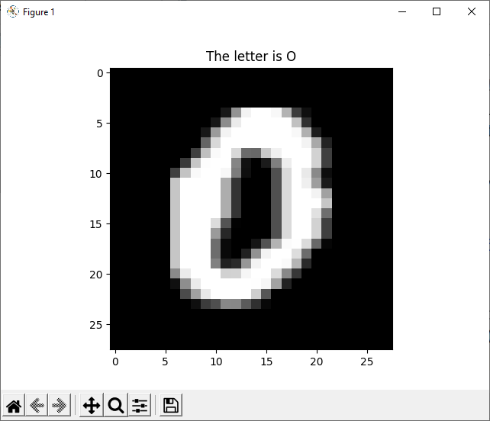

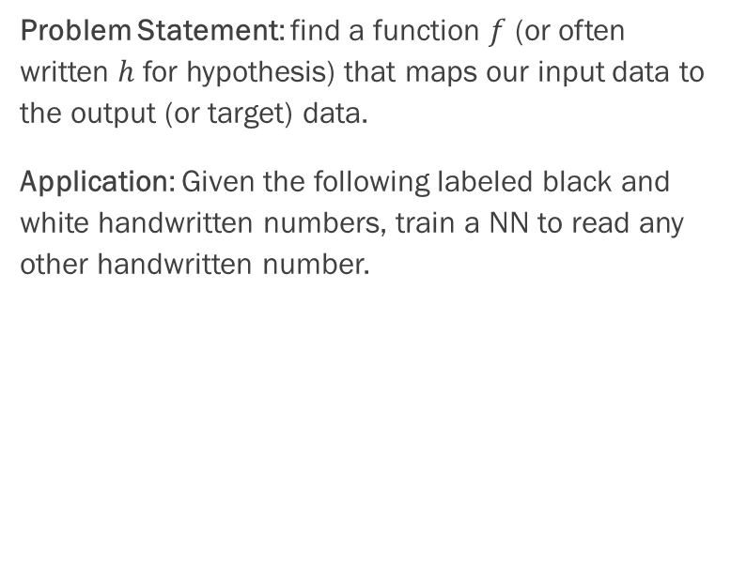
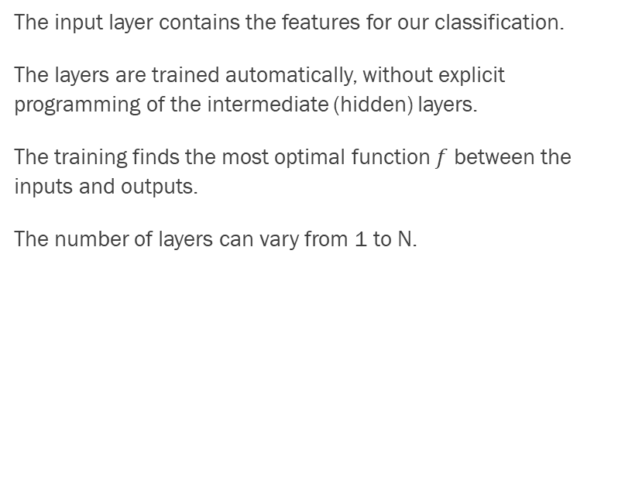
ANN
The input layer contains the features for our classification.
The layers are trained automatically, without explicit programming of the intermediate (hidden) layers.
The training finds the most optimal function $f$ between the inputs and outputs.
The number of layers can vary from 1 to N.
data $X=\left\{x^{(1)},…,x^{(m)} \right\}$ with $x=\left(\begin{matrix}x_{1} \\ ⋮ \\ x_{d}\end{matrix}\right)∈ℝ^{d}$
labels $Y=\left\{y^{(1)},…,y^{(m)} \right\}$ with $y=\left(\begin{matrix}y_{1} \\ ⋮ \\ y_{l}\end{matrix}\right)∈ℝ^{l}$
Problem Statement: find a function $f$ (or often written $h$ for hypothesis) that maps our input data to the output (or target) data.
Application: Given the following labeled black and white handwritten numbers, train a NN to read any other handwritten number.
?
$$Y=f\left(X\right)=h_{θ}(X)$$

Slide 39
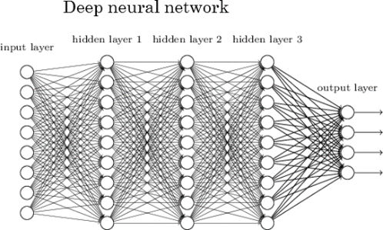
Deep Neural Network (DNN)
“Deep” NN is an ANN where the number of hidden layers is large.
There is some debate as to what is considered large. Many researchers believe that an ANN with 3 or more hidden layers is considered to be deep.
The network on the right is called fully connected as all neurons between adjacent layers are fully connected.

Slide 40

Convolutional Neural Network (CNN) – inspired by human visual cortex
Human visual cortex contains cells that are responsible for only small regions of the total visual field; neighboring cells have overlapping ‘responsibilities’, or receptive fields; all put together a full map of the visual space is produced
CNNs add one or more convolutional layers as the input to the network.
CNNs use filters (or kernels) for feature extraction from the input, and they can learn these filters. They do not have to be manually engineered (see feature engineering).
CNNs have various layers in the NN
Convolution layer – extract features from the input
Pooling layer
Fully connected layer – generate output
And more…
CNNs are especially strong in image and video applications (computer vision) and they are very fast and efficient due to the extraction and pooling techniques.
Convolutions
Kernel ‘scans’ entire image incl. color layers etc. and extracts high-level features such as color gradients, edges, etc.
Pooling
Dimensionality reduction: Dominant (e.g. rotationally invariant) features are extracted and values are aggregated over spatial areas (average or max)
Fully Connected
Final image is flattened (column vector) and fed as input into a feedforward NN

Slide 41
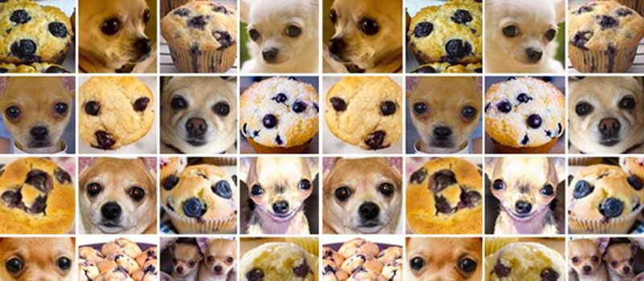
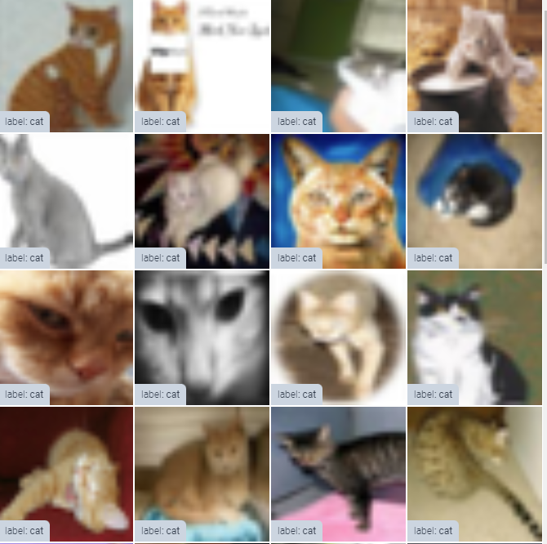
CNN
Problem: Image recognition and computer vision, can we classify images into classes?
Application: Given many images of cats, train a CNN to tell if an image is cat or not cat.
Blueberry Muffin problem ;)

Slide 42





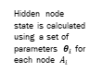


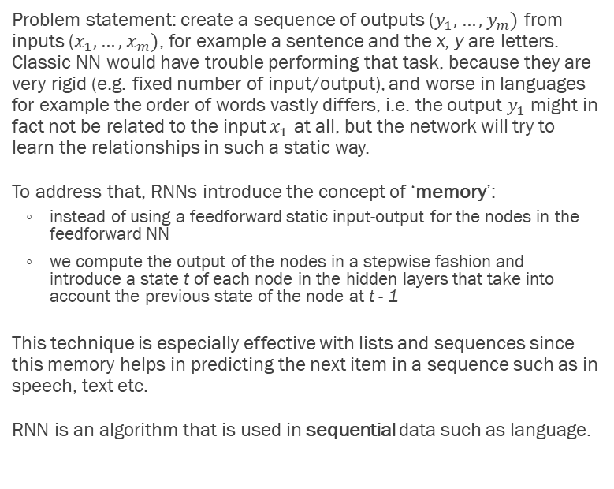







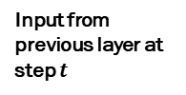



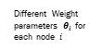
Recurrent Neural Network (RNN)
Hidden node state is calculated using a set of parameters $θ_{i}$ for each node $A_{i}$
Output is calculated by applying an activation function
Problem statement: create a sequence of outputs ($y_{1},…,y_{m})$ from inputs ($x_{1},…,x_{m})$, for example a sentence and the x, y are letters. Classic NN would have trouble performing that task, because they are very rigid (e.g. fixed number of input/output), and worse in languages for example the order of words vastly differs, i.e. the output $y_{1}$ might in fact not be related to the input $x_{1}$ at all, but the network will try to learn the relationships in such a static way.
To address that, RNNs introduce the concept of ‘memory’:
instead of using a feedforward static input-output for the nodes in the feedforward NN
we compute the output of the nodes in a stepwise fashion and introduce a state t of each node in the hidden layers that take into account the previous state of the node at t - 1
This technique is especially effective with lists and sequences since this memory helps in predicting the next item in a sequence such as in speech, text etc.
RNN is an algorithm that is used in sequential data such as language.
$$x_{1}$$
$$A_{1}$$
Output $y_{1}$
$$x_{2}$$
Input from previous layer
$$A_{2}$$
Output $y_{2}$
$$x_{3}$$
$$A_{3}$$
Output $y_{3}$
$$x_{4}$$
$$A_{1}^{t−1}$$
Different Weight parameters $θ_{i}$ for each node $i$
$$x_{1}^{t}$$
$$A_{1}^{t}$$
Output $y_{1}^{t}$
Input from previous layer at step $t$
$$x_{2}^{t}$$
$$x_{3}^{t}$$
Repeated for each t = 1, … , n
$$x_{4}^{t}$$

Slide 43
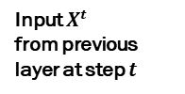

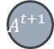
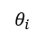

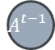
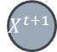


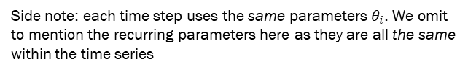
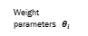
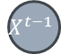

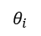
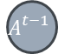



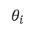
Recurrent Neural Network (RNN)
It turns out though, that RNNs can be depicted in a way that makes them easier to understand, this is called unrolling:
Each time slice is a one-directional graph similar to a feedforward Neural Network.
$$A_{}^{t−1}$$
Output $y_{}^{t−1}$
Output $y_{}^{t}$
Output $y_{}^{t+1}$
Weight parameters $θ_{i}$
=
$$x_{1}^{t}$$
$$A_{}^{t}$$
Output $y_{}^{t}$
$$A_{}^{t−1}$$
$$A_{}^{t}$$
$$A_{}^{t+1}$$
Input $X^{t}$ from previous layer at step $t$
$$x_{2}^{t}$$
$$x_{3}^{t}$$
Repeated for each t = 1, … , n
$θ_{i}$
$θ_{i}$
$θ_{i}$
$$x_{4}^{t}$$
$$X^{t−1}$$
$$X^{t}$$
$$X^{t+1}$$
Side note: each time step uses the same parameters $θ_{i}$. We omit to mention the recurring parameters here as they are all the same within the time series

Slide 44
RNN
Problem: Given a sequence of observations, predict the next observation.
Application in speech recognition
Application Language translation
Application in stock price prediction
E.g. Autocomplete text.
Me: Do you want to grab lunch after class?
You: Yes, sounds… (good)
E.g. translate languages:
English: Do you want to grab lunch after class?
German: Möchtest du nach dem Unterricht zu Mittag essen?
How would a normal NN correlate input letters and output letters??

Slide 45
LSTM (Long Short-Term Memory) – now we are talking about Context again
If we are trying to predict the last word in a sentence, for example
“My car has four wheels”
It is fairly simple to infer from the words before that it can only be wheels. We have enough context in the previous words.
Now take the sentence:
“My dog’s breed is …”
Obviously we need context from earlier words or sentences way back to know what word to put next. This is called long-range dependency.
RNNs have proven to be ineffective in solving for long-range dependencies.
To solve this problem, a long short-term memory cell is introduced which has memory.
The neural network can learn what to store in the long-term state and what to throw away and what to read from it.
The basic concept centers around a new function that’s introduced, called Gate.

Slide 46
LSTM (Long Short-Term Memory) – now we are talking about Context again
Gates control how information is treated within each time step. We have 3 basic Gates:
Input Gate: store new memories
Forget Gate: forget old memories
Output Gate: output the value to the next time step
LSTM uses sigmoid functions like the logistic function (0/1) and tanh (-1/1) (in a smooth / differentiable way) in 3 Steps:
1. Determine what information to forget.
Example: forget the subject from the previous sentence.
2. Determine what information to store instead.
Example: store the new subject of the sentence.
3. Decide what to output.
Example: output the gender and plurality of the subject so that the verbs in the sentence can all be conjugated correctly

Slide 47



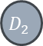

















Autoencoders
By doing this, the NN can learn what features are relevant what data can be discarded
It is actually an unsupervised ML (but we included it under Supervised – NN).
This is an example of NN used in an unsupervised way!
Autoencoders have a simple idea: learn the identity function to find interesting features of the data.
We place additional constraints on the network and limit the number of hidden nodes. The NN then learns a sparse representation of the input.
$$x_{1}$$
$${\hat{x}}_{1}$$
$$x_{2}$$
$$E_{1}$$
$$D_{1}$$
$${\hat{x}}_{2}$$
$$x_{3}$$
$$C_{1}$$
$${\hat{x}}_{3}$$
$$E_{2}$$
$$D_{2}$$
$$x_{4}$$
$$C_{2}$$
$${\hat{x}}_{4}$$
$$E_{3}$$
$$D_{3}$$
$$x_{5}$$
$${\hat{x}}_{5}$$
$$x_{6}$$
Encoder
Compressed Code
Decoder
$${\hat{x}}_{6}$$
$$\hat{X}=f\left(X\right)≈X$$

Slide 48
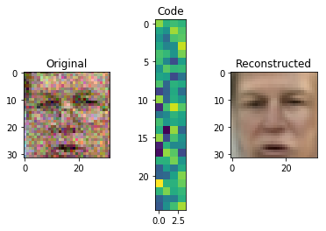
Autoencoders
Applications: de-noise images, anomaly detection, deepfakes, threat analysis in networks.
Problem: Using an unsupervised NN, reconstruct the input as the output using compressed (sparse) representation.
The advantage of this is that we can extract important features.
Autoencoders can be used for Principal Components Analysis (which we discussed earlier in this lecture)
The goal is to reconstruct the input as the output.
https://stackabuse.com/autoencoders-for-image-reconstruction-in-python-and-keras/

Slide 49
Transformers – more context!
Attention is an important aspect of NLP.
Here Attention means that the NN is capable of paying attention to the entire sentence (or set of sequences) as is required in language (think of stories).
However, Attention is ALSO capable of focus to determine what part of the input we should keep and what part to discard. Some parts of the input are looked at in high-resolution, and other parts in resolution. Like humans do!
Problem: Do NLP tasks that require attention, e.g story telling, text summarization
Application: GPT-3 Generative Pre-trained Transformer – 3
Also ChatGPT
https://beta.openai.com/playground

Slide 50
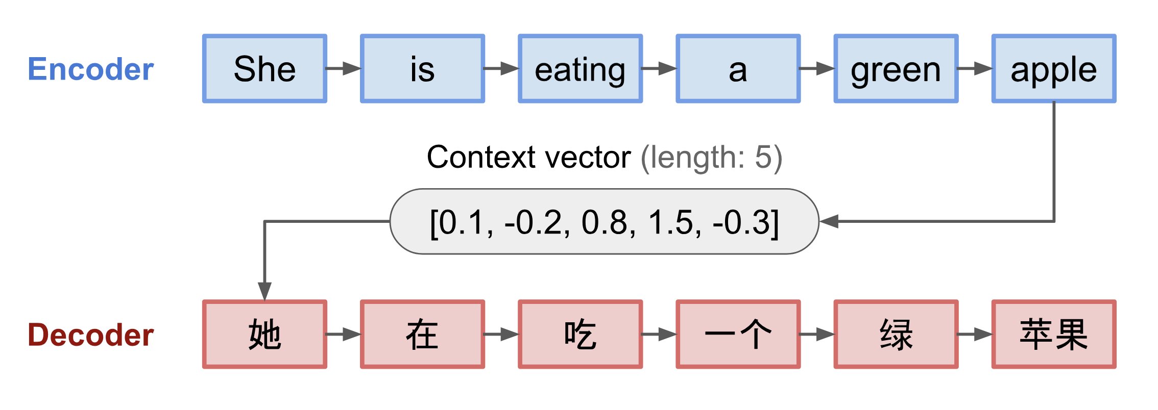
Transformers – more context!
The concept of Attention captures context by assigning weights to relations between words or pixels
In order to predict one element we look at how strongly this element is correlated with (one also says ‘attends to’) other elements. As always in Neural Networks we take these weights and create a linear combination (sum) of each individual element multiplied by the weights to calculate the target.
Transformers base on the Sequence-to-Sequence model (seq2sqe) proposed by Sutskever in 2014 ([1409.3215] Sequence to Sequence Learning with Neural Networks (arxiv.org))
The concept uses an Encoder / Decoder architecture and BOTH are RNNs
The Encoder basically compresses the input data into a context vector of fixed length
The Decoder then produces the output using the context vector as the starting point (initialization)
Example translation into Chinese, from Weng (2018), Attention? Attention! | Lil'Log (lilianweng.github.io)

Slide 51
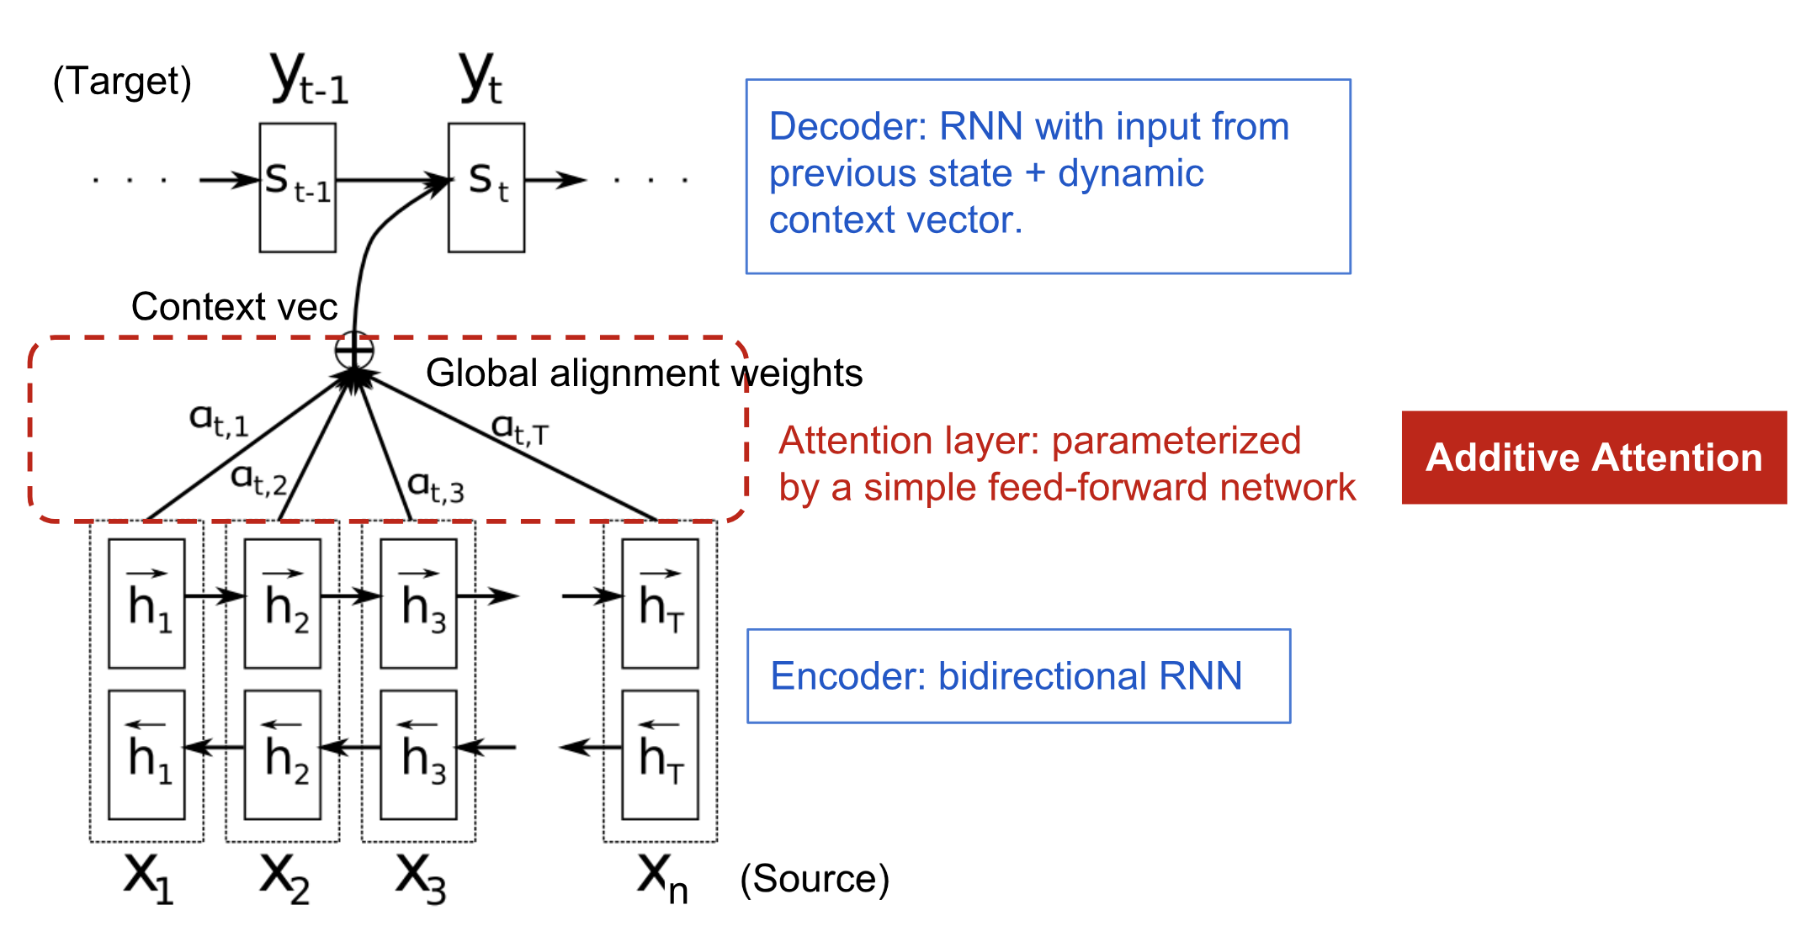
Transformers – more context!
A big disadvantage of the context vector is its fixed-length. It leads to the network forgetting the first part of the sentence before completing it.
In 2015 Bahdanau et al., 2015 proposed the Attention mechanism to memorize long source sentences
The basic idea is let the context vector additionally keep track of the whole input sequence and its alignment with it; this alignment is represented using weights, which enables the context vector to keep long-term correlations
From Bahdanau et al., 2015 and Weng (2018)

Slide 52
Transformers vs. LSTM -> GPTs
LSTMs are a special class of RNNs that use special functions (Gates) to control a memory cell within each timestep of the RNNs
Transformers use a different method to keep track of correlations: Attention
Transformers are generally much faster to train than LSTMs because they have less parameters and LSTMs have to sequentially process the input, whereas Transformers can process in parallel
Transformers can also be pre-trained, whereas LSTMs cannot
GPT (Generative Pre-Trained Transformer) models are Neural Networks that use the transformer architecture and that are pre-trained on large data sets of unlabeled text (-> unsupervised)
OpenAI introduced the first one in 2018 (Improving language understanding with unsupervised learning (openai.com )

Slide 53
Story Generation GPT-3 – GPT = Generative Pre-Trained Transformers
Example: “Tell me a science fiction story about a USC student studying artificial intelligence. “
Unlike many of her peers, Jane was not particularly interested in the study of artificial intelligence. She found the whole concept rather boring, to be honest. But Jane was a USC student, and she had to take a class on AI in order to fulfill her degree requirements. So she reluctantly signed up for the class, not expecting to learn anything of value.
But Jane was pleasantly surprised. The class was fascinating, and she found herself really enjoying it. She started to see the potential for artificial intelligence, and how it could be used to help people in their everyday lives. She became one of the top students in the class, and even ended up writing her thesis on AI.
Today, Jane is a successful AI researcher, and she credits her USC education for giving her the foundation she needed to succeed.

Slide 54
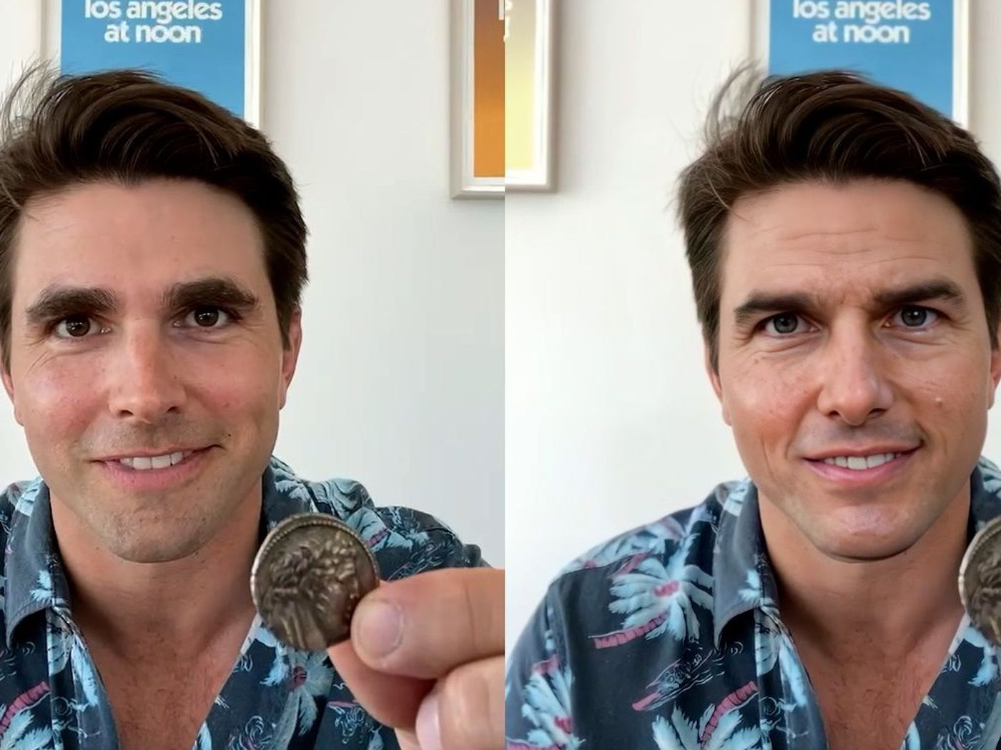
Generative Adversarial Network (GAN)
Two NN compete against each other to generate new data.
Can be used to create new data that has similar distribution as the original data.
Therefore, it can be used by bots to create real sounding audio, video, text, deepfakes.
It can be used to touch up images, fill in gaps, enhance images for the visually impaired.

Slide 55
GAN (Generative Adversarial Network)
Problem: Improve the accuracy of a NN through competing against another NN.
Application: http://gandissect.res.ibm.com/ganpaint.html?project=churchoutdoor&layer=layer4
http://imaginaire.cc/gaugan2/

Slide 56
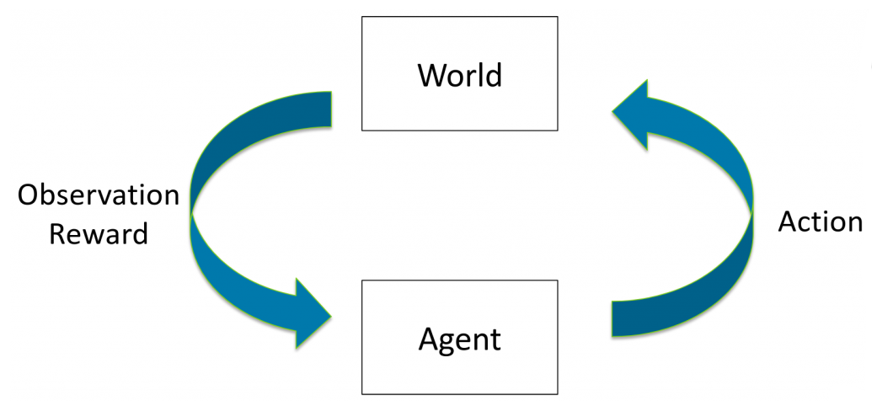
Reinforcement Learning (RL)
Using rewards and penalties as signals to reinforce learning.
A feedback loops allows the agent to learn actions that maximize the rewards it receives.

Slide 57
RL
Problem: Use feedback to reinforce (reward) correct action and penalize wrong actions.
Application: Drive a car in traffic safely – avoid collisions, keep a safe distance, passenger comfort
https://github.com/carla-simulator/carla
Application: Train a simple agent to walk, swim, swing or crawl.
https://developmentalsystems.org/Interactive_DeepRL_Demo/

Slide 58
Summary
In this lecture, we learned about the multitude of approaches for AI. Rule based, searched and ML are the major categories.
During the semester we will study the details of some of these approaches and then apply them to solve problems.
Future courses in the AI minor will go deeper into these approaches to tackle even more difficulty problems (e.g. language).

